Slide 1
MATRIX

Slide 2
MATRIX
Definition:
A matrix is a rectangular array of elements. The horizontal arrangements are called
rows and vertical arrangements are called columns.
Order of a Matrix:
If a matrix A has m number of rows and n number of columns, then the order of the
matrix A is (Number of rows)*(Number of columns) that is,
                A=m*n

Slide 3
MATRIX
Unit (or) Identity Matrix
Zero (or) unit Matrix
Transpose of a Matrix
Triangular matrix
Lower Triangular Matrix
Upper Triangular Matrix
TYPES OF MATRIX:
Row Matrix
Column Matrix
Square Matrix
Diagonal Matrix
Scalar Matrix

Slide 4
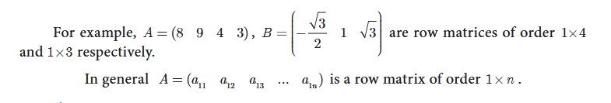
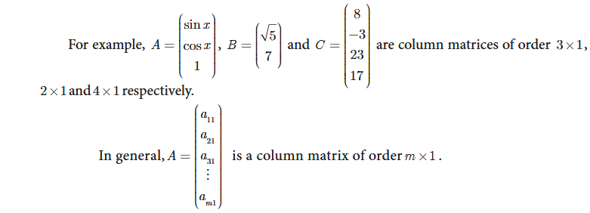
1. Row Matrix:
A matrix is said to be a row matrix if it has only one row and any number of columns.
A row matrix is also called as a row vector.
2. Column Matrix:
A matrix is said to be a column matrix if it has only one column and any number of
rows. It is also called as a column vector.

Slide 5
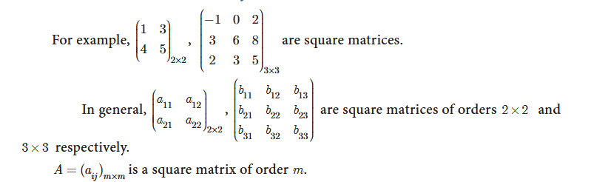
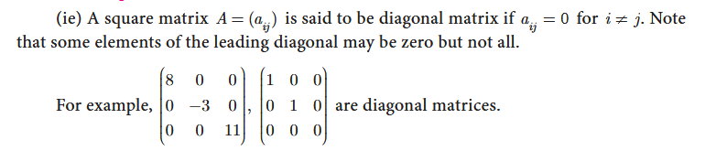
3. Square Matrix:
A matrix in which the number of rows is equal to the number of columns is called a
square matrix.
4.Diagonal Matrix:
A square matrix, all of whose elements, except those in the leading diagonal are zero
is called a diagonal matrix.

Slide 6
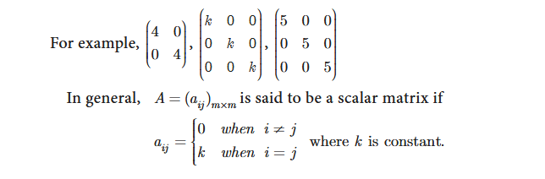
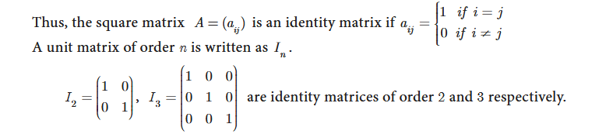
5.Scalar Matrix:
A diagonal matrix in which all the leading diagonal elements are equal is called a
scalar matrix.
6.Identity (or) Unit Matrix:
A square matrix in which elements in the leading diagonal are all “1” and rest are all
zero is called an identity matrix or unit matrix.

Slide 7
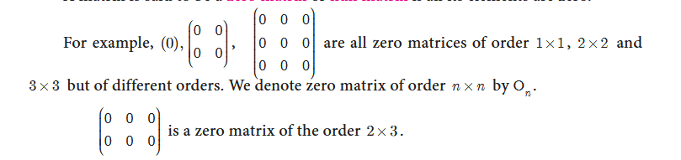
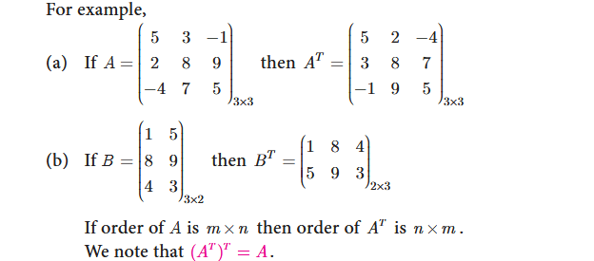
7. Zero (or) Null Matrix:
A matrix is said to be a zero matrix or null matrix if all its elements are zero
8. Transpose of a Matrix:
The matrix which is obtained by interchanging the elements in rows and columns of
the given matrix A is called transpose of A and is denoted by A^{T} .

Slide 8
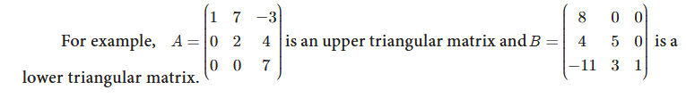
9. Triangular Matrix:
    Lower Triangular Matrix.
    Upper Triangular Matrix.
Lower Triangular Matrix:
A square matrix in which all the entries above the leading diagonal are zero is called
a lower triangular matrix.
Upper Triangular Matrix:
A square matrix in which all the entries below the leading diagonal are zero, then it is called an upper
triangular matrix.

Slide 9

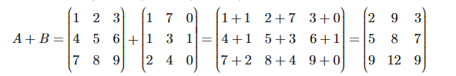
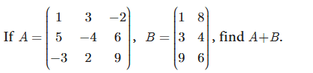
Operations on Matrix:
In this section, we shall discuss the addition and subtraction of matrices, multiplication
of a matrix by a scalar and multiplication of matrices.
Addition and subtraction of matrices
Two matrices can be added or subtracted if they have the same order. To add or
subtract two matrices, simply add or subtract the corresponding elements.
Matrix Addition & Subtraction is only possible in same rows and columns,
Matrix Addition & Subtraction is not possible in different rows and columns,

Slide 10

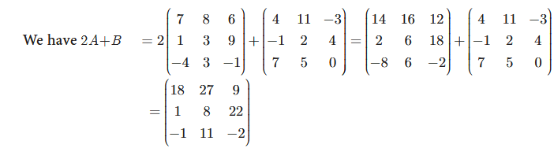
Multiplication of Matrix by a Scalar:
We can multiply the elements of the given matrix A by a non-zero number k to
obtain a new matrix kA whose elements are multiplied by k. The matrix kA is called scalar
multiplication of A.

Slide 11
Properties of Matrix Addition and Scalar Multiplication:
Let A, B, C be m n´ matrices and p and q be two non-zero scalars (numbers). Then
we have the following properties.
(i) A + B= B + A [Commutative property of matrix addition]
(ii) A + (B + C) = (A + B) + C [Associative property of matrix addition]
(iii) (pq) A = p (qA) [Associative property of scalar multiplication]
(iv) IA=A [Scalar Identity property where I is the unit matrix]
(v) P (A + B) = pA + pB [Distributive property of scalar and two matrices]
(vi) (P + q) A = pA + qA [Distributive property of two scalars with a matrix]
Additive Identity:
The null matrix or zero matrix is the identity for matrix addition.
Let A be any matrix.
Then, A + 0 = 0 + A = A. where 0 is the null matrix or zero matrix of same order as that of A.
Additive Inverse:
If A be any given matrix then –A is the additive inverse of A.
In fact we have A + (-A) = (-A) + A = 0.

Slide 12
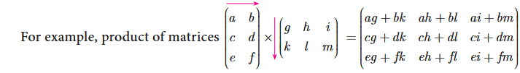
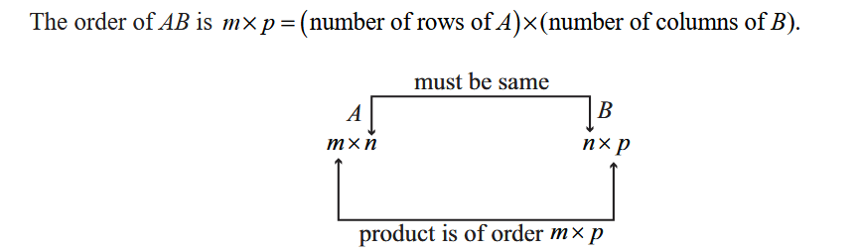
Multiplication of Matrices:
To multiply two matrices, the number of columns in the first matrix must be equal to the number of rows in the second matrix. Consider the multiplications of 3×3 and 3×2 matrices.
(Order of left hand matrix) * (order of right hand matrix) = (order of product matrix).
(3 × 3 ) * (3 × 2 ) = (3 × 2 )
Matrices are multiplied by multiplying the elements in a row of the first matrix by the elements in a column of the second matrix, and adding the results.
The product AB can be found if the number of columns of matrix A is equal to the number of rows of matrix B. If the order of matrix A is m*n and B is n*p then the order of AB is m*p.

Slide 13
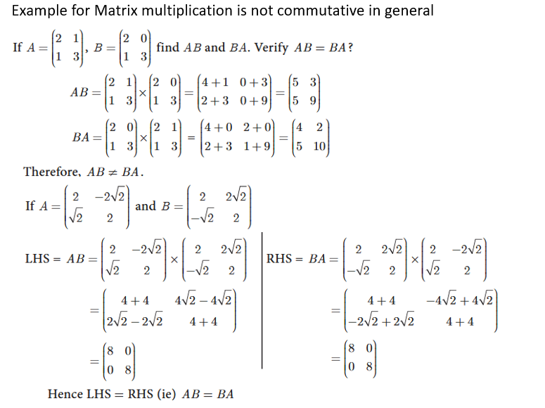
Properties of Multiplication of Matrix:
Matrix multiplication is not commutative in general:
If A is of order m*n and B of the order n*p then AB is defined but BA is not defined. Even if AB and BA are both defined, it is not necessary that they are equal.
In general AB≠BA .

Slide 14
Special cases:

Slide 15
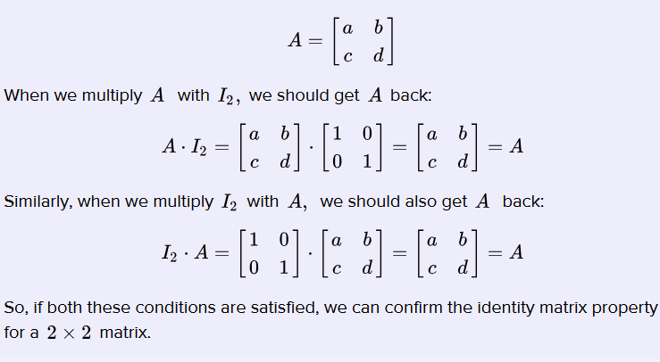
(b) Matrix multiplication is distributive over matrix addition:
(i) If A, B, C are m*n , n*p and n*p matrices respectively then
  A (B + C) = AB + AC (Right Distributive Property)
(ii) If A, B, C are m*n , m*n and n*p matrices respectively then
(A + B) C = AC + BC (Left Distributive Property)
(c ) Multiplication of a matrix by a unit matrix:
If A is a square matrix of order n*n and I is the unit matrix of same order then AI = IA = A.

Slide 16


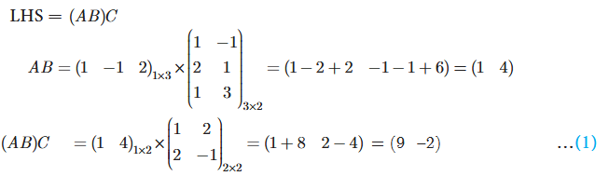
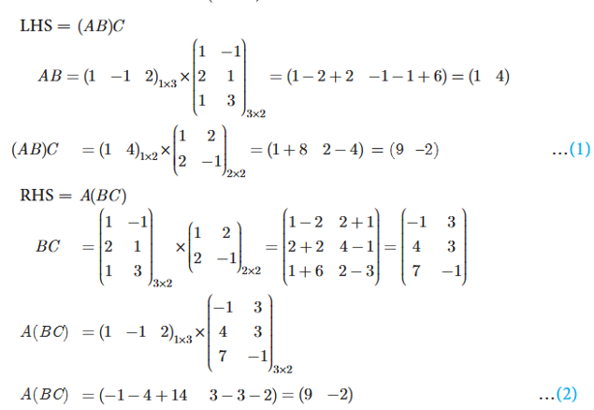

(D) Matrix multiplication is always associative:
If A, B, C are m*n , n*p and p*q matrices respectively then (AB) C = A (BC).
Examples for Matrix multiplication for Associative:

Slide 17


Symmetric and Skew-symmetric Matrices:
Symmetric Matrices:
A square matrix A is said to be symmetric if A^{T} = A.
Skew-symmetric Matrices:
A square matrix A is said to be skew-symmetric if A^{T} = - A.

Slide 18
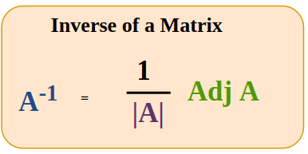
Inverse of a Matrix:
The inverse of a matrix A, denoted as A⁻¹, is a matrix that, when multiplied by A, results in the identity matrix (I). Mathematically, this is represented as AA⁻¹ = A⁻¹A = I. For a matrix to have an inverse, it must be a non-singular square matrix, meaning its determinant is not zero
Not all matrices have an inverse. A matrix must be square (same number of rows and columns) and must be non-singular (its determinant is not zero) to have an inverse.

Slide 19
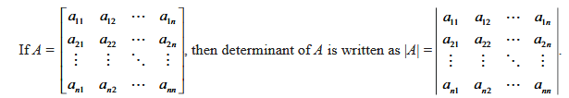


Determinants:
To every square matrix A = [aij] of order n, we can associate a number called determinant of the
matrix A
i) Determinants can be defined only for square matrices.
ii) For a square matrix A, |A| is read as determinant of A.
iii) Matrix is only a representation whereas determinant is a value of a matrix
Determinant of a matrix of order 2:

Slide 20

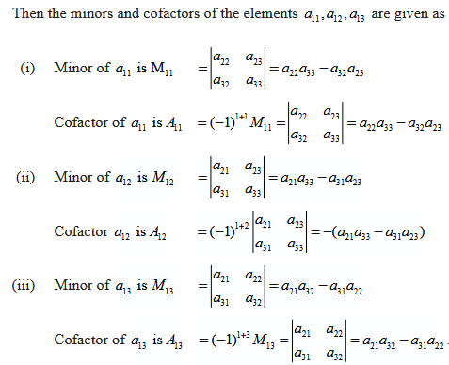
Determinant of a Matrix of order 3:
|A|= a22a33 – a32a23 – (a21a33 - a31a23) + a21a32 - a31a22

Slide 21
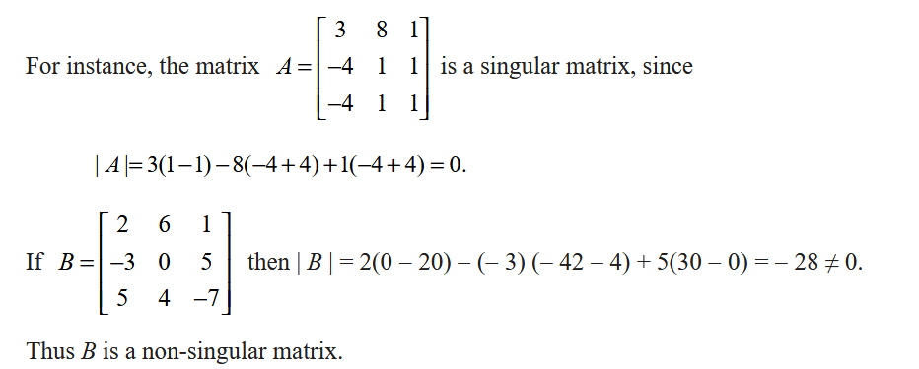
Singular and non-singular Matrices:
A square matrix A is said to be singular if | A | = 0. A square matrix A is said to be
non-singular if | A | ≠ 0.

Slide 22
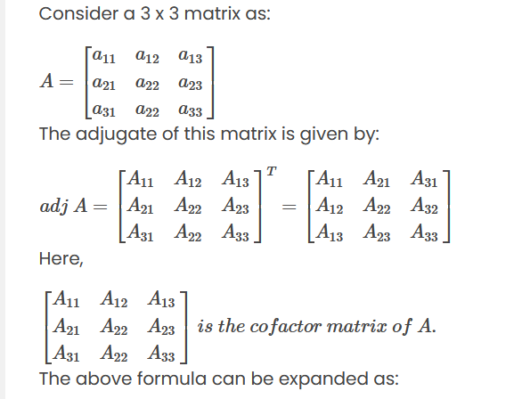
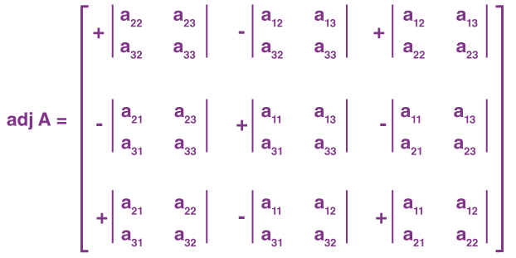
Adjoint of a Matrix:
The adjoint of a matrix A, also called the adjugate matrix, is defined as the transpose of the cofactor matrix of A. It's denoted as adj(a). The cofactor matrix is formed by taking the determinant of the minor matrices of A, with alternating signs, and the transpose is then taken of this matrix. The adjoint is crucial for finding the inverse of a matrix
T

